Slide 1
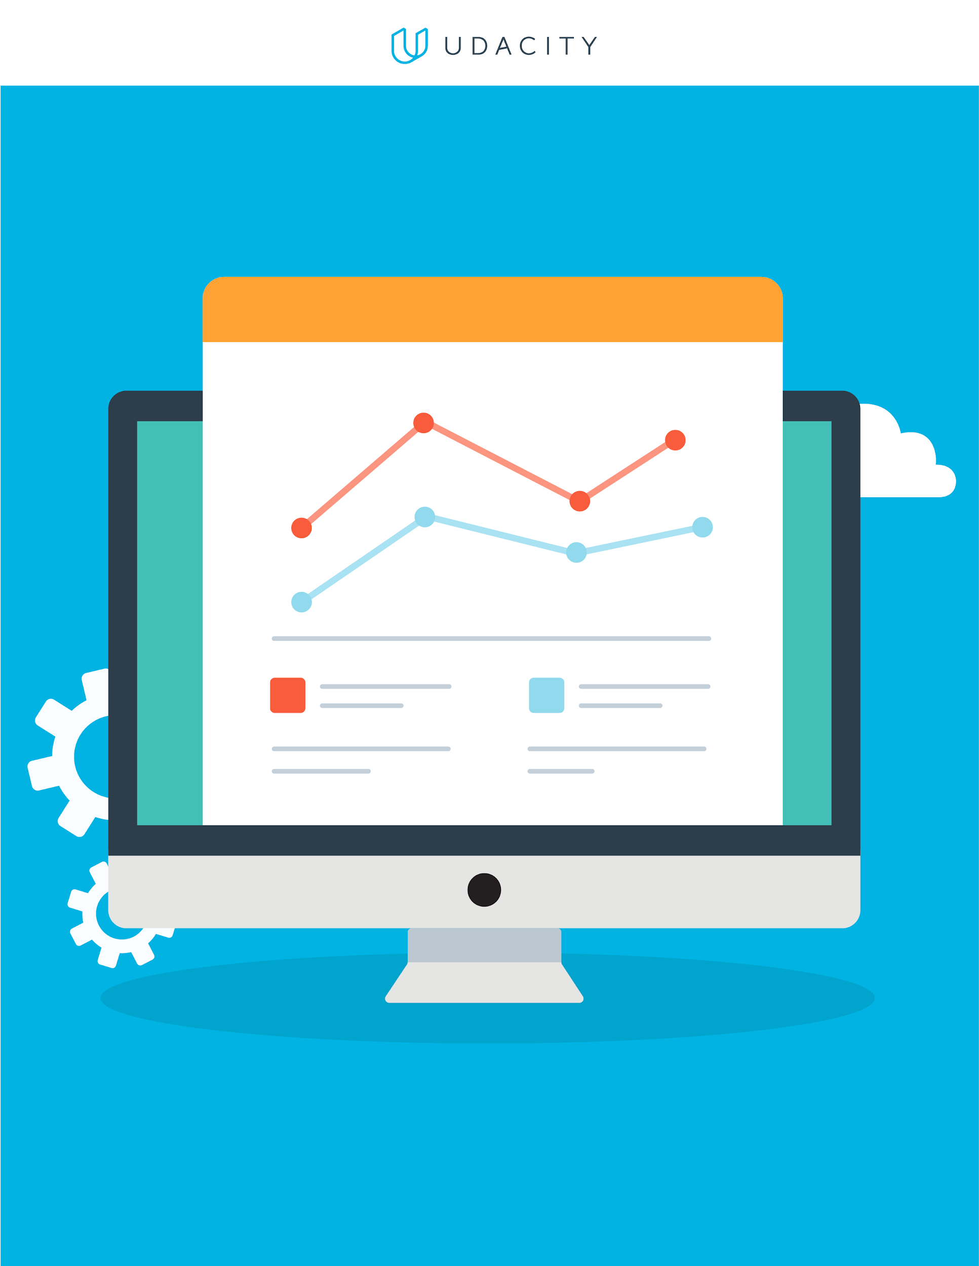
Marketing Data and Technology
Draw Insights from Marketing Data

Slide 2

Part One:
Setting Goals

Slide 3
Identify Key Business Objectives
Key Business Objective: A defined goal or outcome used to plan the desired direction of your company. Write at least 3 but no more than 5 business objectives that support your business model. Each objective should be SMART.
1 | Track 70% or more of website traffic sessions by end of Q1 2026 in order to better understand engagement
2 | Increase the amount of monthly leads for merchandise purchases by 15% by the end of Q4 2025
3 | Increase the average gross sales amount by 10% by end of Q1

Slide 4
Identify Key Performance Indicators
Key Performance Indicator (KPI): A quantifiable metric used to determine how effectively your key business objectives are being met. Ensure that the specific metric is clearly identified.
1 | Percentage of sessions that are properly tracked (have all session data of specific user actions captured)
2 | Number of new leads generated per month
3 | Average order value

Slide 5
Part Two:
A/B Testing Proposal

Slide 6
A/B Testing Proposal: KPI, Variable, and Hypothesis
KPI used as basis for the A/B test
Average Order Value
Variable that will have an impact on the KPI
Showing customer a message regarding being x dollar amount away from getting free shipping with their order
Hypothesis for your A/B Test
By displaying a free shipping threshold message in the cart more customers will decide to add more items and therefore increase the average order value

Slide 7
A/B Testing Proposal: Details and results
Details of the A/B test
Variations being tested: | Control: the cart page does not display any message about free shipping
 | The cart page does display a message about free shipping that updates based on cart value and the free shipping threshold
User groups: | 50/50 split of group A (control) that sees the cart with no message and group B that sees the cart with the free shipping message.
Data collection tool: | Google Analytics and Optimizely
Length of the test: | Collect data from 1,000 completed orders per group (2,000 users total).
Describe how you would determine the results of the A/B test
I would compare the Average Order Value between the control group and the variation group. A higher AOV in the variation group would mean that the test worked well to meet objective.

Slide 8
Part Three:
Data Exploration

Slide 9
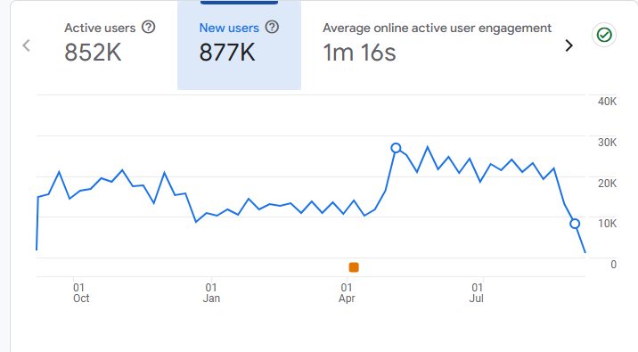
Reports Snapshot
From the Reports Snapshot, select a twelve month time period you would like to explore.
Ensure that the following are visible in the screenshot:
Timeframe
New users
Axis values

Slide 10
Reports Snapshot
Which month had the most new users?
May 2025
Which month had the fewest new users?
Jan 2025
Write some ideas why certain trends are associated with these specific months?
May highest because spring promotions, mid-year sales, people are more socially active, and its far away from expensive holiday seasons.
Jan lowest because there is a drop in shopping after lots of spending in Nov - December.

Slide 11
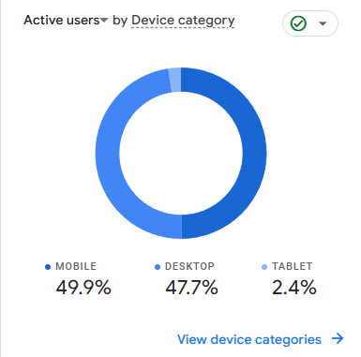
User Tech
Please go into the User → Tech → Tech overview report for the following:
For the twelve month period you’ve chosen, provide a screenshot showing percentage chart (donut charts) of All Users that came from mobile, desktop, and tablet devices.
Ensure that the following are visible in the screenshot:
Device Category
Donut chart showing % breakdown by device
Note that the time frame selected does not need to be visible in the screenshot..
Replace this box with screenshot from repor

Slide 12
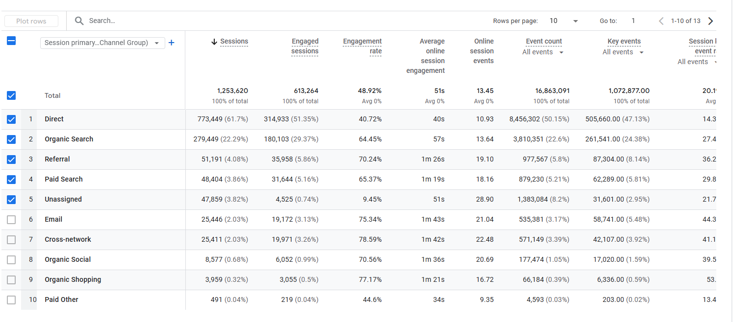
User Acquisition
For this section, if you are using your own business’s Google Analytics data but do not have eCommerce capabilities established, please use the Google Analytics demo data provided from the Google Merchandise store.
Take a screenshot that shows the Engagement rate of the different acquisition channels over a 12 month period.
Ensure that the following are visible in the screenshot:
Channel group
Users
Engagement Rate
Note that the time frame selected does not need to be visible in the screenshot, but will be reflected by the number of users.

Slide 13
User Acquisition
Which channel groups had the highest and lowest engagement rates?
Highest: Cross-network
Lowest: Unassigned
Which channel groups had the highest and lowest total revenue?
Highest: Direct
Lowest: Unassigned
What do these metrics mean, based on your experience?
Cross-network users are traffic from targeted ads shown across Google platforms
Unassigned means unclear tracking / unintentional traffic so not surprising its the lowest both because of campaign efforts and unintentional traffic isn’t a high conversion
Direct users come to site because they are familiar with the brand and are often return clients / high conversion

Slide 14
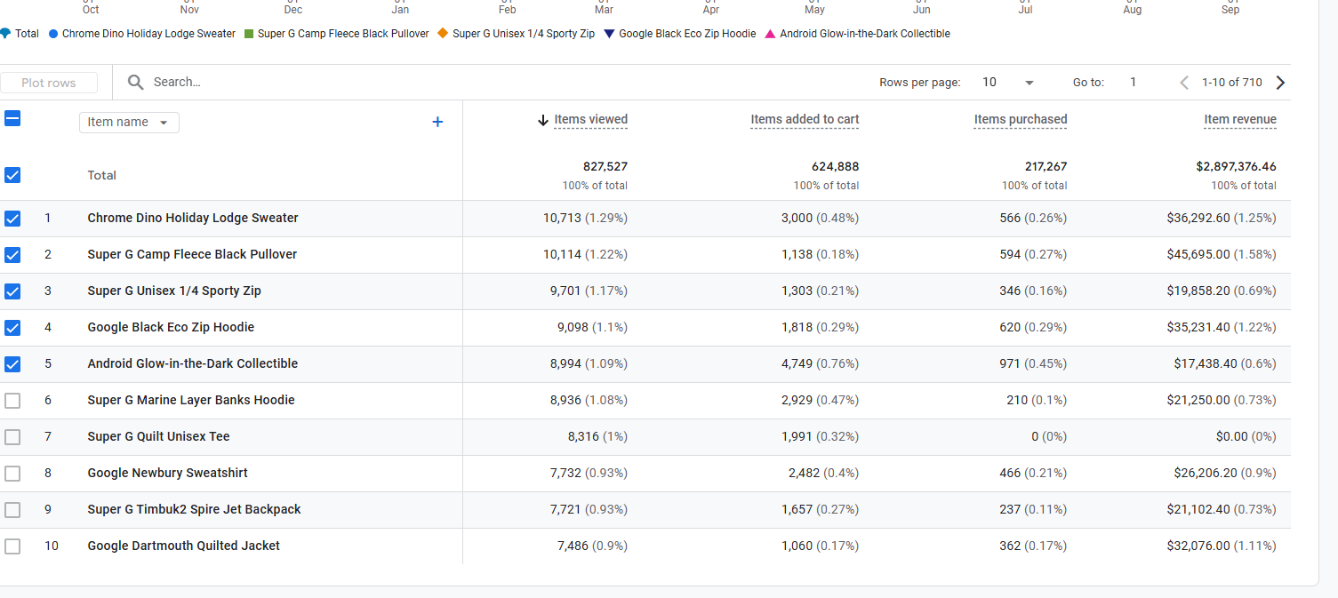
Monetization
For this section, if you are using your own business’s Google Analytics data but do not have eCommerce capabilities established, please use the Google Analytics demo data provided from the Google Merchandise store.
During the twelve month period you’ve selected, provide a screenshot that shows the Item name that contributed the highest number of unique purchases and the item name that was responsible for the largest percentage of revenue? (Screenshot(s) only; no annotation required.)
Ensure that the following are visible in the screenshot:
Item names
Number of items purchased
Item revenue

Slide 15
Part Four:
Segmentation

Slide 16
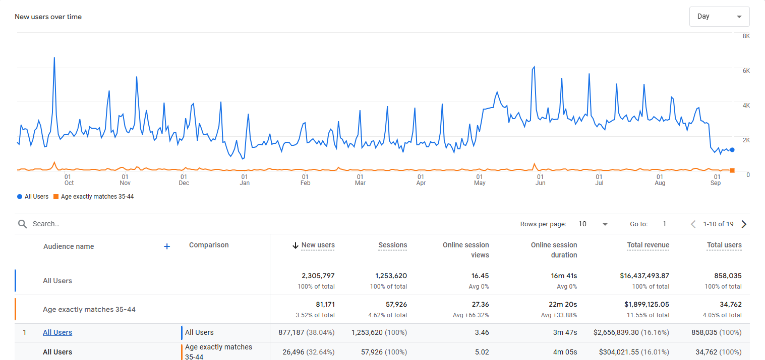
Audience Segment: Demographics
Place the screenshot here, that includes a comparison of your chosen Audience Demographic segment and “All Users”
Values used: | “Age exactly matches 35-44”

Slide 17
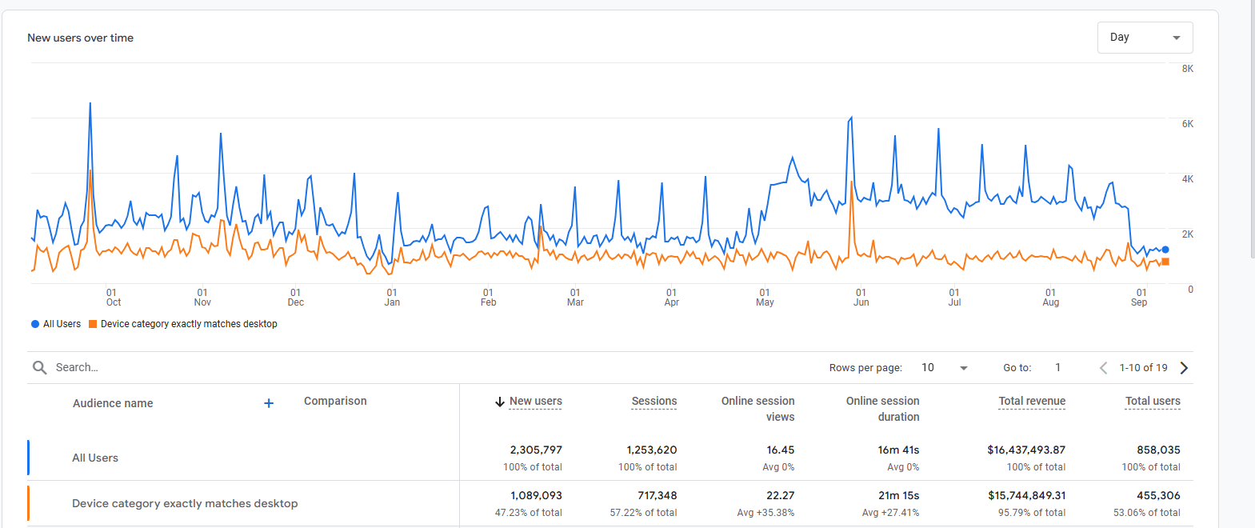
Audience Segment: Technology
Place the screenshot here, that includes a comparison of your chosen Audience Demographic segment and “All Users”
Values used: | Device category exactly matches desktop

Slide 18
Part Five:
Analysis and Suggestions

Slide 19
Analysis and Suggestions: Instructions
In this part, you will improve your business's future by providing recommendations regarding marketing spending, website updates, and technologies to use.
To demonstrate your knowledge:
Using the cost, revenue, and ROAS for campaigns, determine how you might be able to achieve 20% growth without increased cost.
Identify eCommerce changes that could be used to improve the business.
Chose three emerging technologies that can help the business.
Remove this slide

Slide 20
Google Merchandise Store data
You can find the results of the Google Merchandise Store campaigns below.
Campaign Name | Cost | Revenue | ROAS
Tech Trends: Discover the Latest Google Gear | $5,000 | $3,000 | 0.6
Shop with Google: Unleash Your Digital Lifestyle | $5,000 | $8,000 | 1.6
Google Gadgets Galore: Elevate Your Tech Game | $5,000 | $8,000 | 1.6
Gear Up with Google: Your One-Stop Tech Shop | $8,000 | $13,000 | 1.625
Google Merch Madness: Score Big on Tech Essentials | $5,000 | $2,000 | 0.4
Unlock the Power of Google: Shop the Best in Tech | $2,000 | $3,500 | 1.75
Totals | $30,000 | $37,500

Slide 21
Business Sales Growth
Based on the data provided, how might the campaigns be realigned and improved to potentially achieve a 20% YOY sales growth without additional cost? You can assume that the data will remain consistent over the projected time frame. Please reference specific data to support your answer, such as metrics and campaigns.
You could get the answer by asking yourself: Which campaign would I spend less, and which would I spend more?
To make at least 20% more in revenue ($7500+) I would cut the most ineffective campaigns which are Google Merch Madness and Tech Trends. Then take that $10000 saved on costs and reallocate it to 2 top ROAS performers which are Unlock the Power of Google: Shop the Best in Tech 1.75 ROAS and Gear Up with Google: Your One-Stop Tech Shop 1.625 ROAS.

Slide 22
eCommerce improvements
UX change:
Create a side panel with the categories that is more intuitive to use than the top across layout of options, the side panel is a more common display UX. Also smaller image icons that show price when hovering over them.
Other eCommerce change or addition:
Option to buy wholesale

Slide 23
Technology
It is time for some exploration! You need to find 2 emerging marketing technologies that you could use in a technology stack. For each one, you need to describe why you would use that tool.
1 | AI Agent Chat Bot
 | To improve shopping experience by allowing 1 on 1 conversation to explore customer wants/needs and make FAQ more interactive for user
2 | Social Commerce (linked to social media shops)
 | Wider audience funnel / more accessible

